Slide 1



NAD Young Adult Sabbath School
Young Adult Sabbath School
Tracy Wood, Xavier Moss, Kayla Goodman

Slide 2

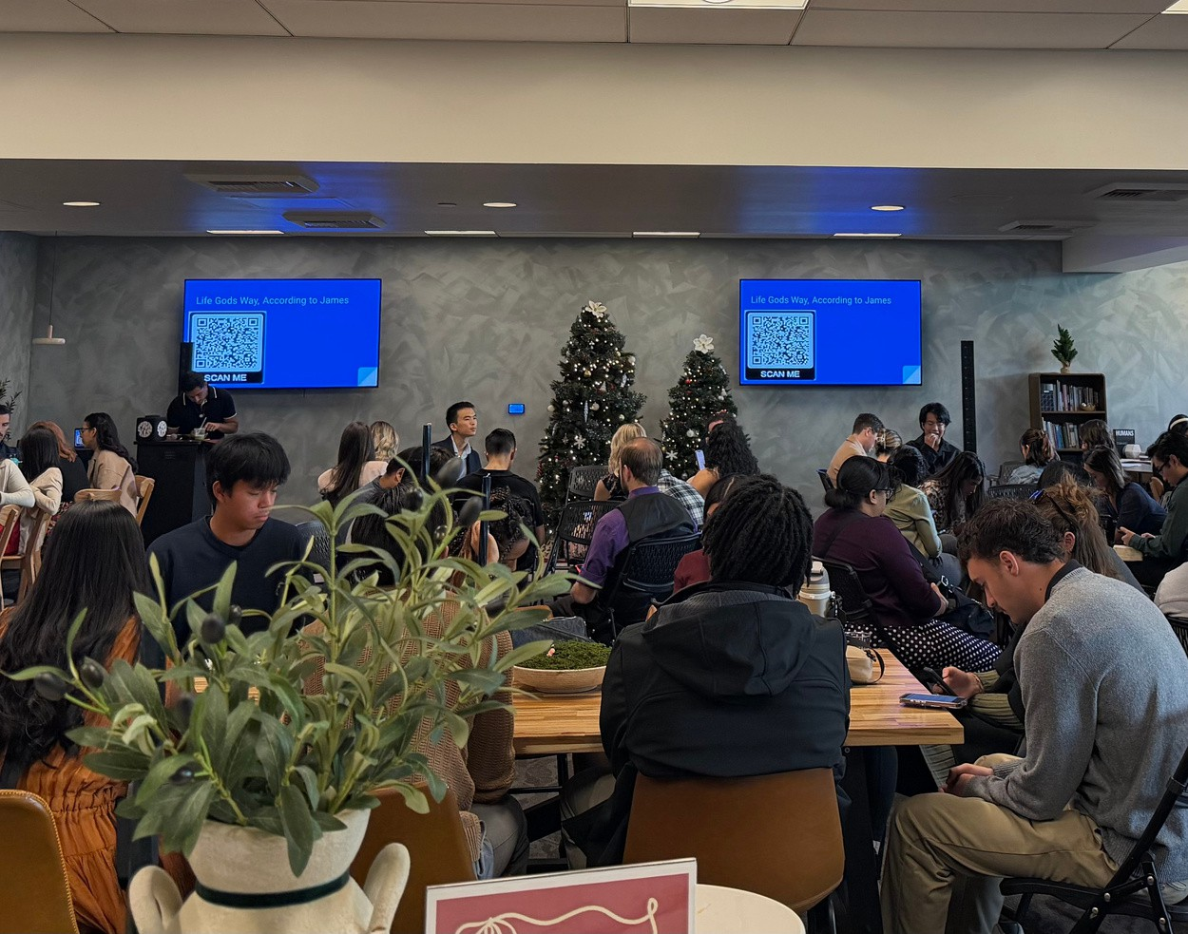
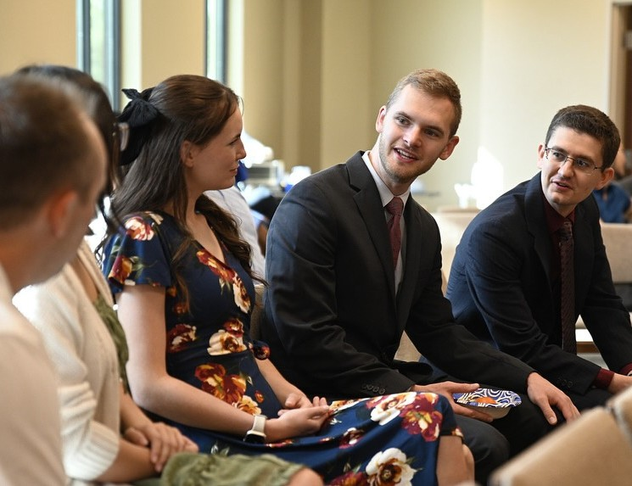

Who We Are
NAD Young Adult
Sabbath School
Praxis Ministry at Loma Linda University Church
Combined Youth/YA/Young Professional Sabbath School at Spring Meadows Church

Slide 3
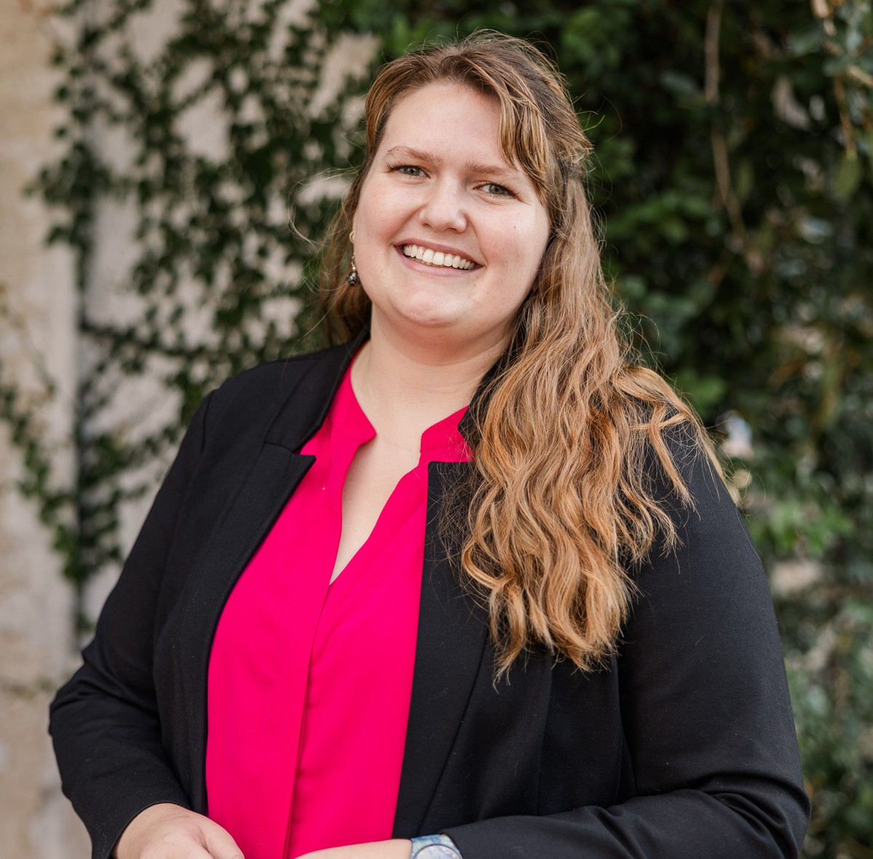

The Panelists
NAD Young Adult
Sabbath School
Kayla Goodman
Xavier Moss

Slide 4
It takes 1 person
NAD Young Adult Sabbath School
You make a difference in your young adult community!

Slide 5


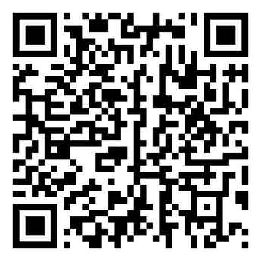
NAD Young Adult Sabbath School
Conversation
Connection Community Challenge Consistency
The 5 C’s
Find it on the NAD website

Slide 6
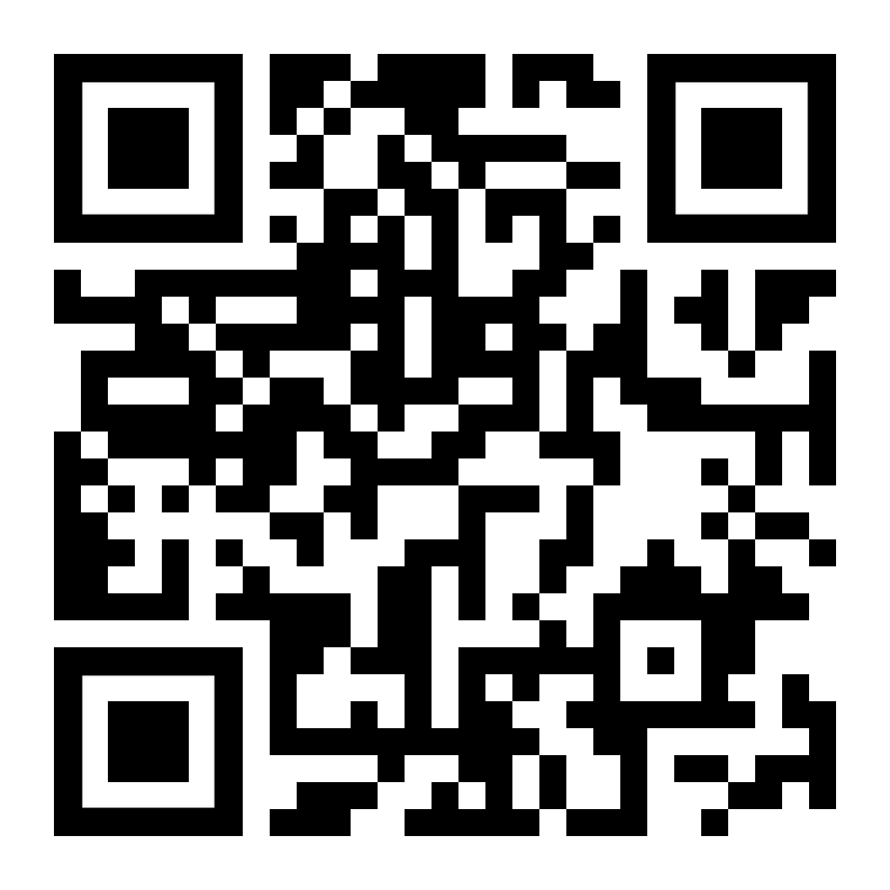

Slide 7



Conversation
NAD Young Adult Sabbath School
Overview
Create safe spaces for people to communicate
True connection starts with intentional, meaningful conversations that respect differences and create safe spaces to explore faith together. By practicing empathetic, active listening, we foster deeper understanding and stronger relationships. This kind of communication ignites a powerful cycle— conversation leads to connection, connection builds community, and community drives spiritual growth and consistency. If we want to cultivate lasting change and community among young adults, we must embrace the art of dialogue that plants seeds for genuine transformation.
Submit Your Questions Here:

Slide 8


NAD Young Adult Sabbath School
Practical Application
Practice this in your table discussion groups!
Or online, in the group chat. You have 5 minutes.
Open your Bibles to Genesis 6 to 9 on the story of Noah. Your theme for Sabbath School is on God’s Promises.
Delegate 3 people Create an exciting hook to share on the theme of God’s promises.
Delegate 3 people
Bring one piece of NEW information to light that people do not commonly know about. Tie it to God’s promises.
Delegate 3 people Create relevance to this story. How does it relate to young adults today? Tie it to
God’s promises.
Submit Your Questions Here:

Slide 9


Connection
NAD Young Adult Sabbath School
Overview
Create safe spaces to connect emotionally, spiritually, intellectually, socially
Connection is the key to emotional, spiritual, intellectual, and social growth, and it happens best when people feel safe to be vulnerable. Sabbath School can be a powerful space for this, but it depends on leaders who create open, welcoming environments where people can share honestly without judgment. By getting to know each person, gathering feedback, and staying connected throughout the week, we build deeper relationships that strengthen our faith journey. Without real connection, our efforts may fall short, but with it, we create a lasting, supportive community.
Submit Your Questions Here:

Slide 10
NAD Young Adult Sabbath School
Practice this in your table discussion groups!
Or online, in the group chat. You have 5 minutes.
Practical Application
Refer to John 4; Jesus meets the Samaritan woman where she already is, at an ordinary well, in the middle of her routine.
Part 1
What helps someone feel safe enough to stay in a spiritual conversation today—and where might our Sabbath School unintentionally make that harder?
Part 2
How can we create space for honesty in Sabbath School without people feeling judged, fixed, or put on display?
Part 3
What would it look like for connection here to continue throughout the week in ways that feel supportive, not intrusive?
Submit Your Questions Here:

Slide 11



Community
NAD Young Adult Sabbath School
Overview
Create safe spaces where people do life together outside of Sabbath School
The term “Sabbath School” can unintentionally alienate those unfamiliar with it, while “Bible Study” is more inclusive and accessible to non-Christians. By using more welcoming terminology and fostering thoughtful, safe conversations, we create meaningful connections that lead to organic community growth. This approach helps young adults feel a sense of belonging, not just in church, but in homes, coffee shops, and other spaces where real relationships can flourish. True camaraderie grows when we make space for natural, unforced connection.
SSuubbmmiitt YYoouurr QQuueessttiioonnss HHeerree::

Slide 12
NAD Young Adult Sabbath School
Practical Application
Refer to Acts 17:22-31 the story of Paul and the “Unknown God”
Practice this in your table discussion groups!
Or online, in the group chat. You have 5 minutes.
Whole Table
Come up with examples of “Adventist Jargon” what words or phrases do we use that are inaccessible
Half of Table
How do we break our jargon down for non-Adventists
Other Half of Table Talk about ways that we can be more inclusive
Submit Your Questions Here:

Slide 13



Challenge
NAD Young Adult Sabbath School
Overview
Create safe spaces for open dialogue and exploration
Sabbath School leaders who act as facilitators create a culture that encourages open dialogue and welcomes diverse perspectives, allowing participants to challenge their beliefs meaningfully. By fostering trust through conversation, connection, and community, they empower individuals to explore ideas they may have never considered. This approach honors disagreements and ensures everyone feels seen and accepted. Ultimately, by facilitating discussions in a supportive environment, leaders enable faith to grow and evolve in profound ways.
Submit Your Questions Here:

Slide 14
NAD Young Adult Sabbath School
Practical Application
Practice this in your table discussion groups!
Or online, in the group chat. You have 5 minutes.
Open your Bibles to Genesis 6 to 9 on the story of Noah. Your theme for Sabbath School is on God’s Promises.
Each person will create a challenging question, based on the story of Noah
Take 1-2 minutes to create a question.
Ask your question at your table. If you hear an interesting question and want further understanding of why they are asking it, use the phrase “Tell Me More”. Sometimes, the individual is not asking about the specific question - they have a deeper issue/concept they are trying to understand.
Submit Your Questions Here:

Slide 15



NAD Young Adult Sabbath School
Overview
Create safe spaces that are not rushed but real, genuine, authentic
Consistency
Consistency is key to building reliability and trust in Sabbath School, allowing young adults to feel secure and supported in their faith journey. When they see a commitment to showing up and engaging genuinely, it fosters an environment where they can open up without fear. This reliability is especially important for those healing from church hurt, as it helps them develop the trust they need to grow and connect with both God and community. By embodying God's consistent presence, Sabbath School becomes a safe haven for young adults to strengthen their faith and relationships.
Submit Your Questions Here:

Slide 16
Practical Application
Practice this in your table discussion groups!
Or online, in the group chat. You have 5 minutes.
NAD Young Adult Sabbath School
Refer to Ruth 1:6-18 and ask yourself: “Where has someone’s steady presence helped me heal—or where has inconsistency made me pull away?”
PART 1
Who might be the “Naomis” in our young adult Sabbath School?
What signals might tell us someone needs consistency more than enthusiasm?
PART 2
What does Ruth-style consistency look like in Sabbath School practically?
Based on the above answers, “Would this action help someone feel safe enough to come back?”
PART 3
What is one way you can personally embody consistency?
What is one communal habit your Sabbath School could adopt that signals reliability?
Submit Your Questions Here:

Slide 17



NAD Young Adult Sabbath School
Conclusion
It doesn’t take much to facilitate a young adult sabbath school.
It just takes one person who is willing to allow God to work in them and through them.
Stay curious, ask ‘Tell me more’, and be open to what young people are sharing at your church.
We hope you can bring back the 5C’s to your young adult communities and spaces!
Submit Your Questions Here:

Slide 18


Q&A
NAD Young Adult Sabbath School
Thank you for joining us!

